Slide 1
Data Science Summer Course Linear Regression Models in R
John Binzak
June 25, 2019

Slide 2
The Plan: A completely unblind study
Play a math game
Learn a little numerical cognition theory (data upload)
Make predictions
Fit linear models to gameplay data
Test predictions
Come up with follow-up analyses
Fit linear models to gameplay data
Test follow-up predictions

Slide 3
Fractions War

Slide 4
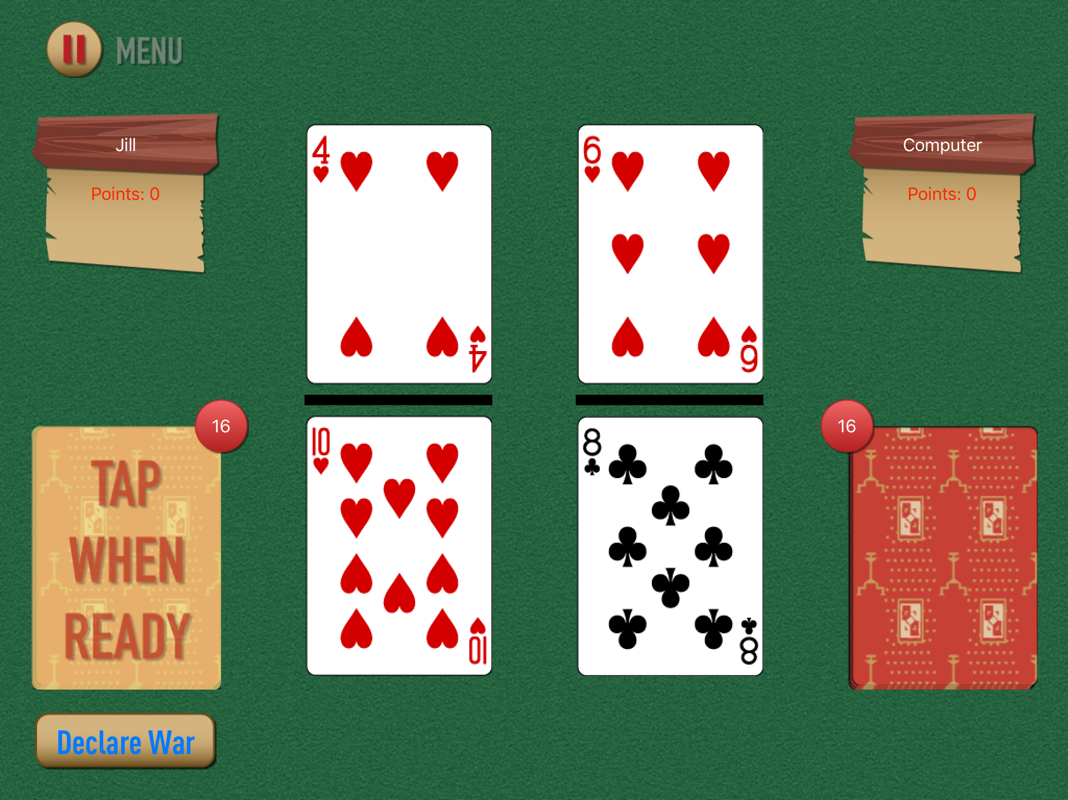
Goal:
Win all the cards and earn the most points.
The player with the larger fraction wins the cards.
The player who swipes the cards in the right direction first wins a point.
Declare War when both fractions have the same value.

Slide 5
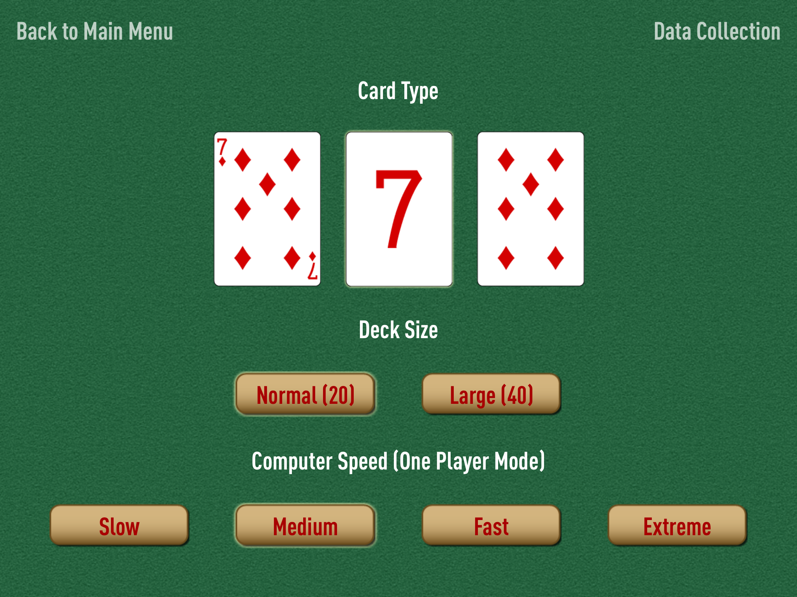
Game Options
Card type orders
1
2
3
Traditional Cards
Numerals
Pips (Suits)
Pips (Suits)
Traditional Cards
Numerals
Numerals
Pips (Suits)
Traditional Cards
Player Name = [3 letters]_[Game#] = e.g. JVB-1

Slide 6
Numerical Cognition

Slide 7
Which number is larger? Left or Right?

Slide 8
15
93

Slide 9
+

Slide 10
51
49

Slide 11
+

Slide 12
91
75

Slide 13
Was it easier or harder when numbers were closer together?

Slide 15
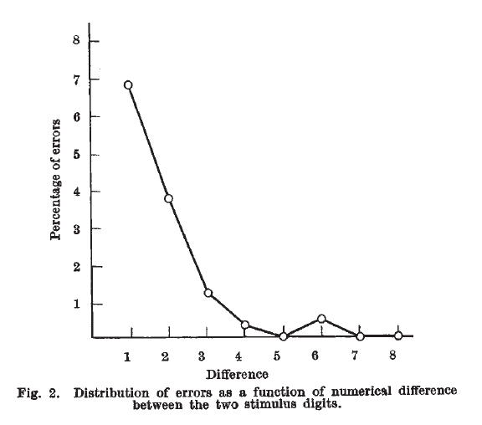
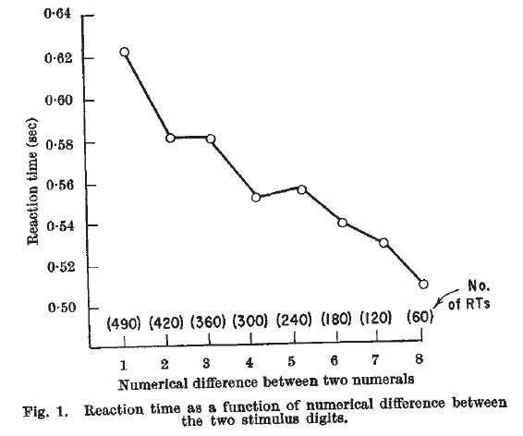
Numerical Distance Effects
As the distance between two numbers increases, the response time and error rate decreases
“The decision process which these data suggest is one in which the displayed numerals are converted to analogue magnitudes and a comparison is made between these magnitudes in much the same way that comparisons are made between physical stimuli such as loudness or length of time.”
- Moyer & Landauer, 1976, Nature

Slide 16
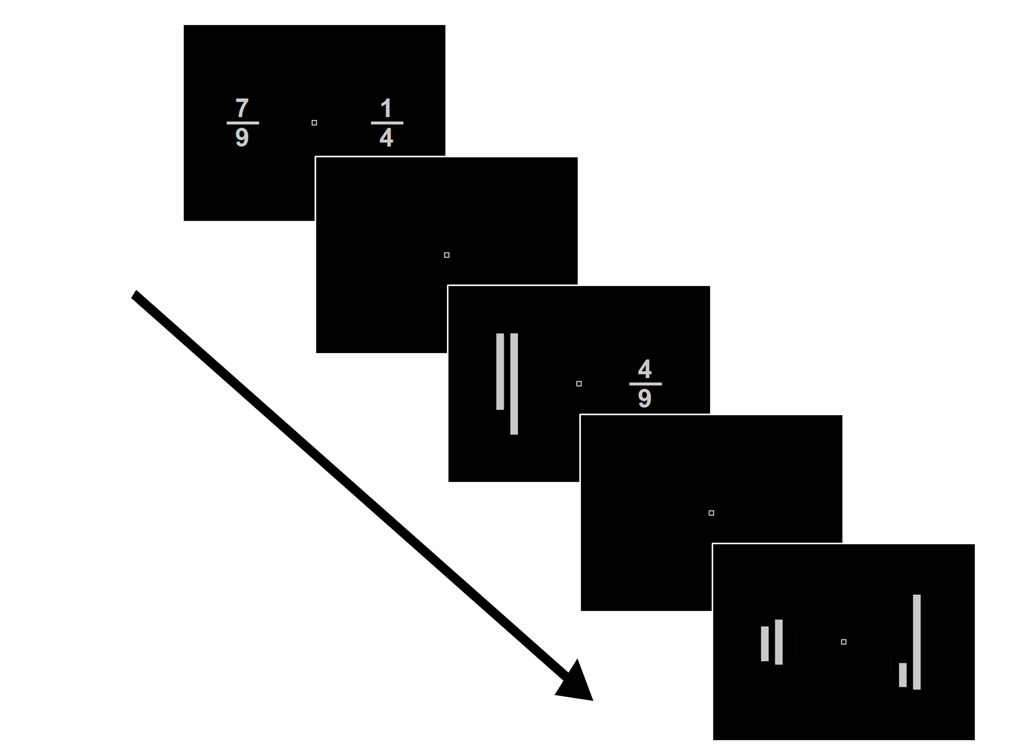
NDE’s today…
RT ~ Dist * type + (Dist) * type | Subject)

Slide 17
Value of Linear Regression
Estimating linear relationships, & null hypothesis testing
Controlling for variance explained by one variable when testing the effect of another
Explaining how the effect of a variable depends on the effect of another (Interactions)
Predictive Analysis
Given knowledge about variables and outcomes, we can determine which variables are useful for predicting future outcomes

Slide 18
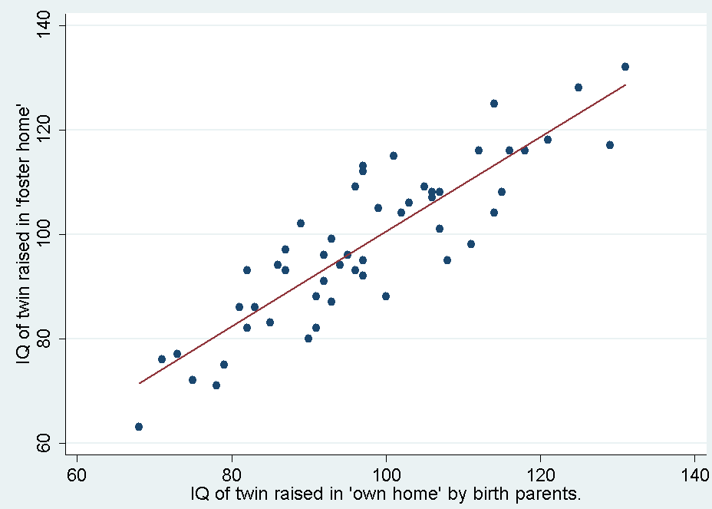
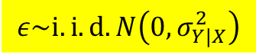
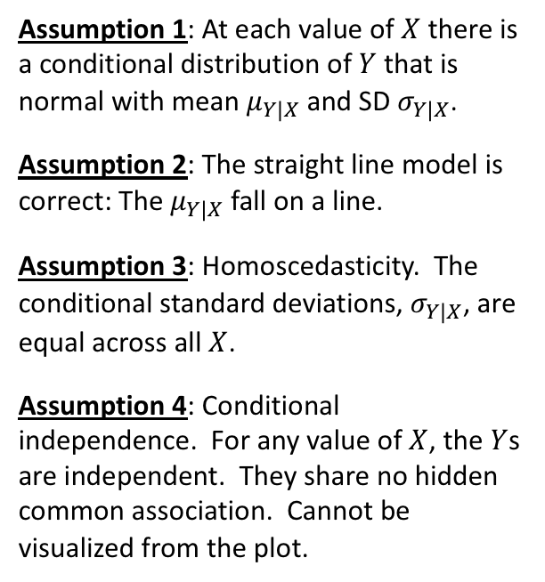
The linear regression model and its four assumptions
$$ε\sim i.i.d. N\left(0,σ_{Y|X}^{2}\right)$$
Assumption 1: At each value of $X$ there is a conditional distribution of $Y$ that is normal with mean $μ_{Y|X}$ and SD $σ_{Y|X}$.
Assumption 2: The straight line model is correct: The $μ_{Y|X}$ fall on a line.
Assumption 3: Homoscedasticity. The conditional standard deviations, $σ_{Y|X}$, are equal across all $X$.
Assumption 4: Conditional independence. For any value of $X$, the $Y$s are independent. They share no hidden common association. Cannot be visualized from the plot.

Slide 19
Gameplay Predictions

Slide 20
Gameplay Predictions
Will there be distances effects in gameplay response times & acc?
Will there be differences in response times and accuracy between the different cards?
Will the distance effects be present in some card types but not others?
Are there other factors besides numerical distances that should explain performance important?

Slide 21

Disclaimer

